Slide 1

Does LA city employee compensation growth align with housing price growth?
Team:
Susan Quiros,
Elijah Abuel
Harika Peddiraju
Mohan Panga

Slide 2
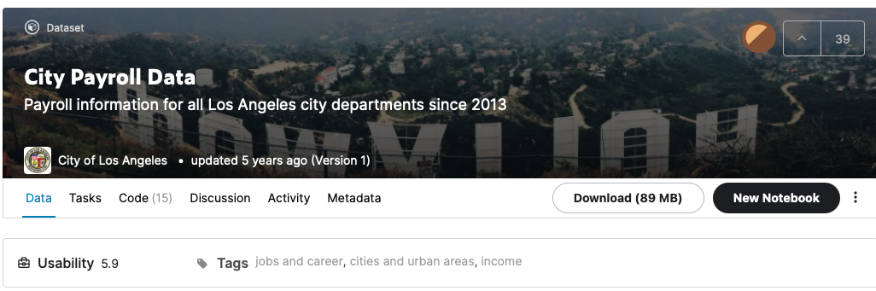
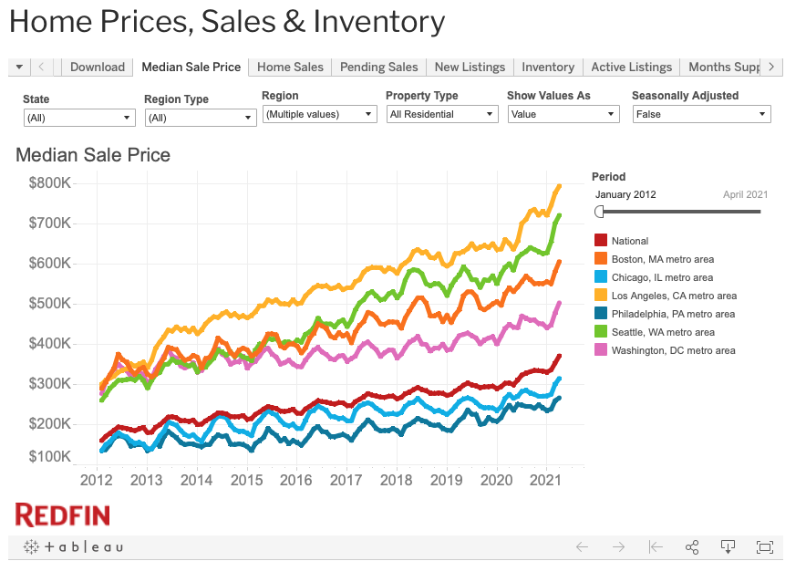
Data Sets
Kaggle: Los Angeles Public Sector Salaries
https://www.kaggle.com/cityofLA/city-payroll-data
Data from 2013 to 2016
Redfin: Housing Prices in LA
https://www.redfin.com/news/data-center/
2013 to 2021

Slide 3
Data Analysis Workflow
Data Cleaning
Selecting Departments
Analyzing
Top 4
Job Class Titles
Housing Price
vs
Salary Growth
58 total departments
Selected:
Fire
Police
Recreation & Parks
Water & Power
~ 100-325 job titles per department
Analyzed 2013, 2014, 2015
base pay
total payments
benefit cost
% increase in housing price vs. base pay for selected job titles
Drop NA & missing values
Data Typecasting

Slide 4
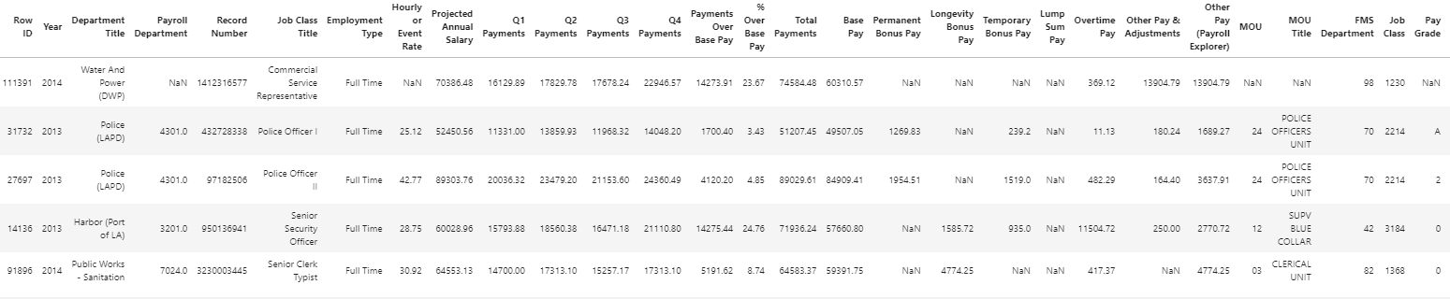
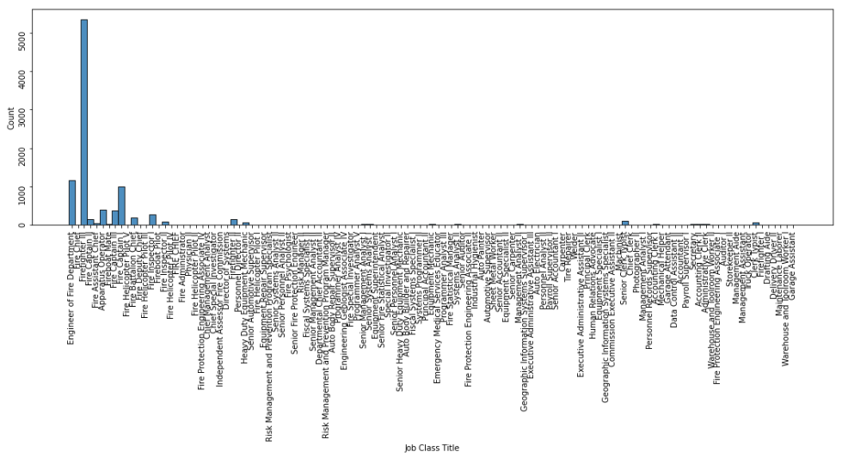
Data Overview
285008 records ✕ 36 fields
e.g. Job Class Titles in Fire Department

Slide 5
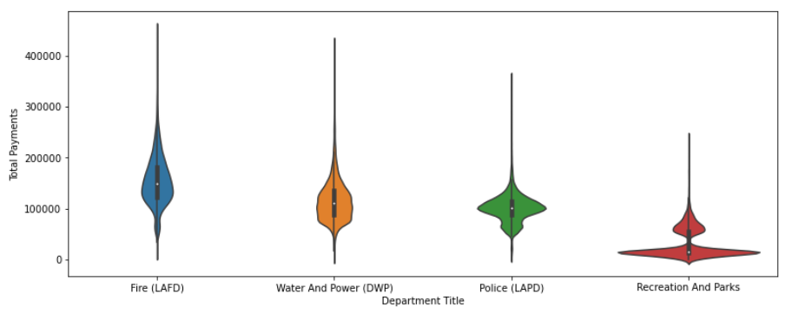
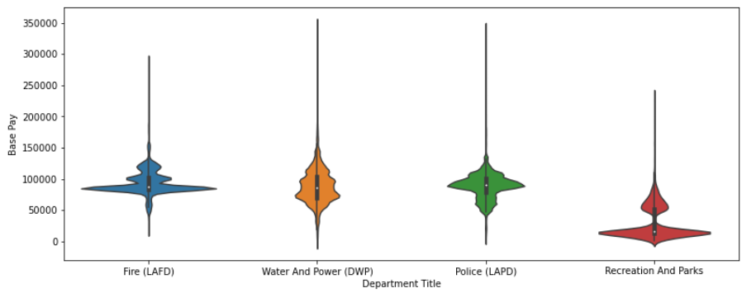
Salary Distribution
Selected top 4 job class titles based on number of records
Fire Department has higher average total payments
Recreation and Parks has lower pay than other departments

Slide 6
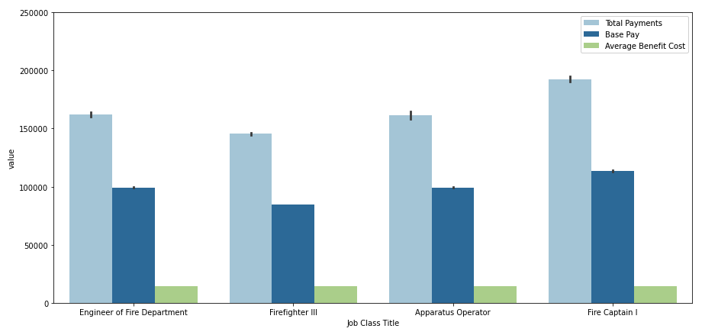
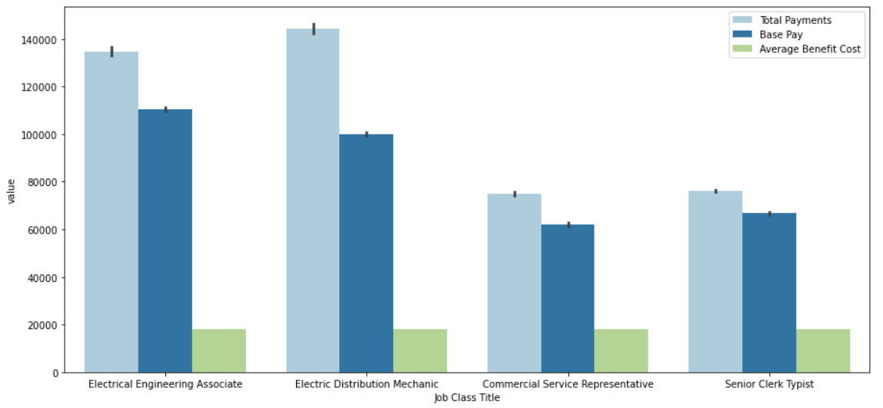
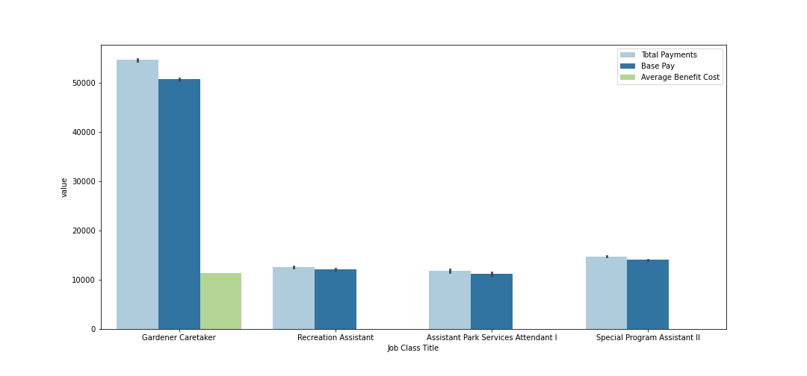
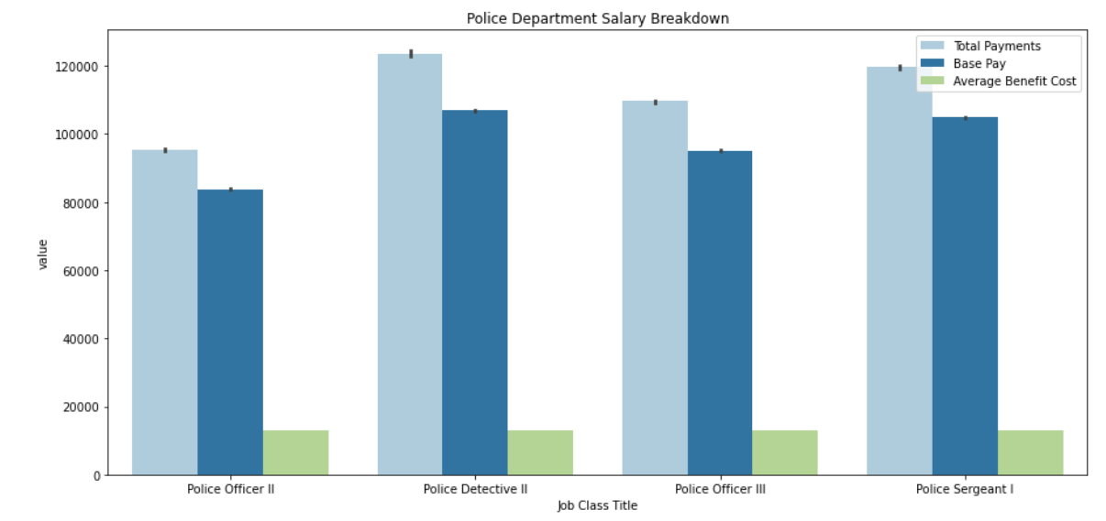
Salary Breakdown Overview
Fire Department
Recreation & Parks
Police
Water & Power

Slide 7
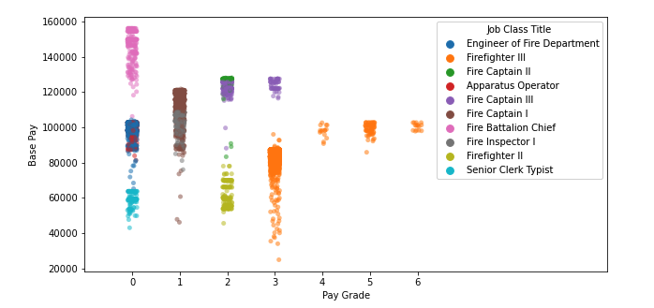
Pay Grade

Slide 8
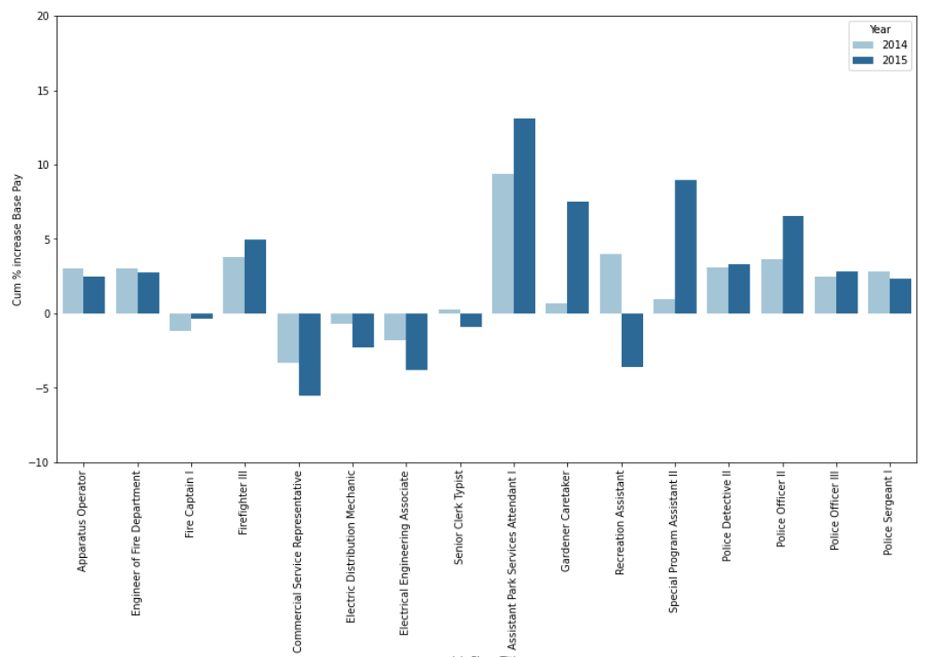
Salary Growth
Fire
Water & Power
Recreation & Parks
Police

Slide 9
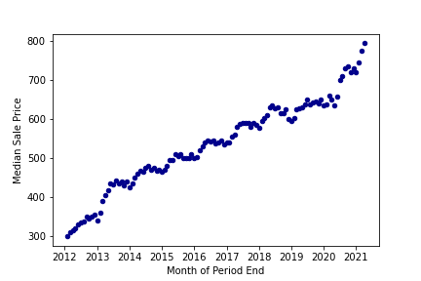
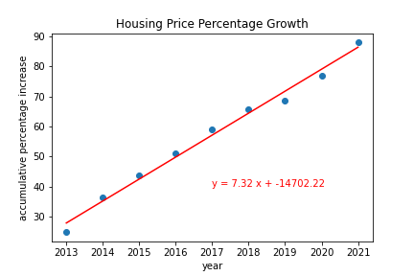
Housing
~ 7% increase in median home price YoY

Slide 10
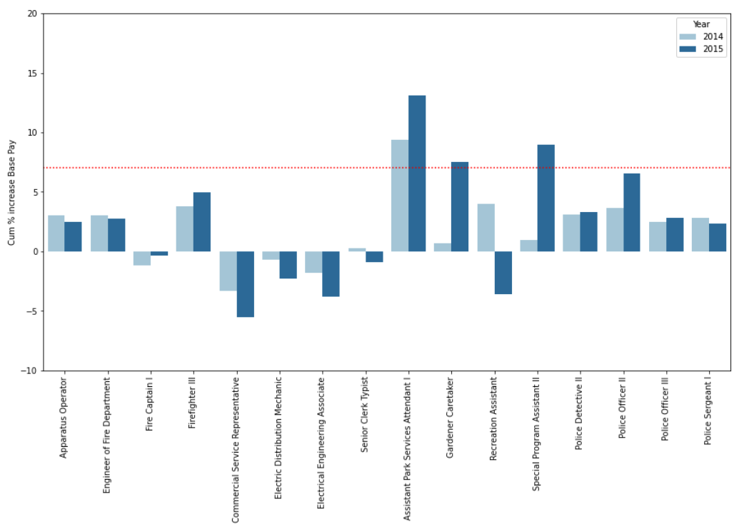
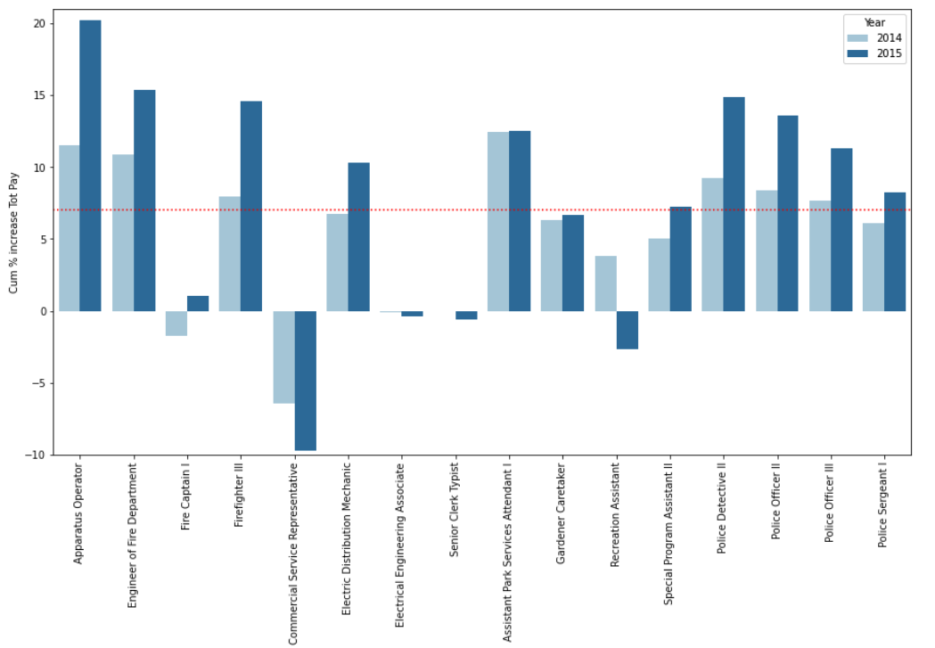
Housing vs Salary Growth
Fire
Water & Power
Recreation & Parks
Police
Fire
Water & Power
Recreation & Parks
Police
Out of 16 job titles,
base pay of only 3 positions matches or exceeds housing price % growth
however, total pay of 9 positions matches or exceeds housing price % growth

Slide 11
Back up

Slide 12
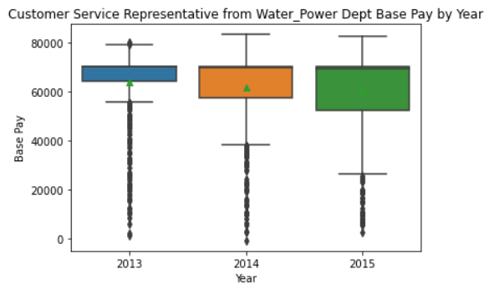
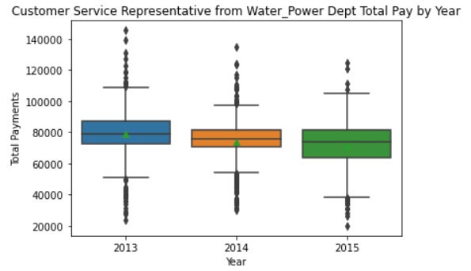
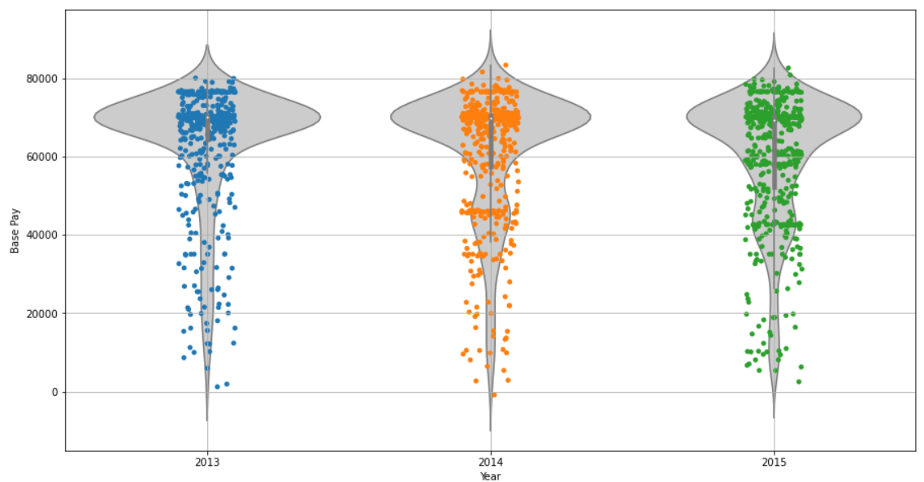
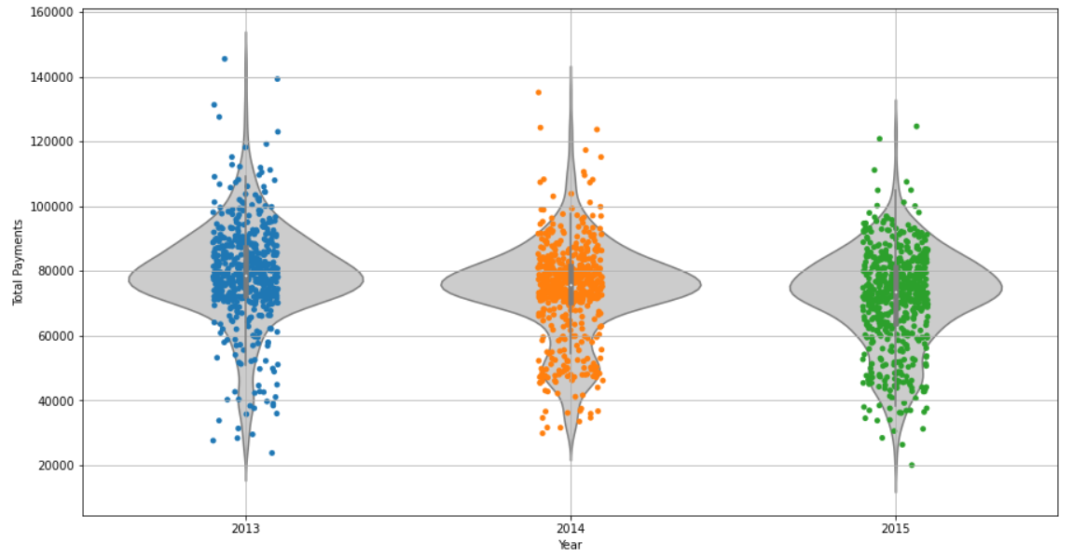
Back up

Slide 13
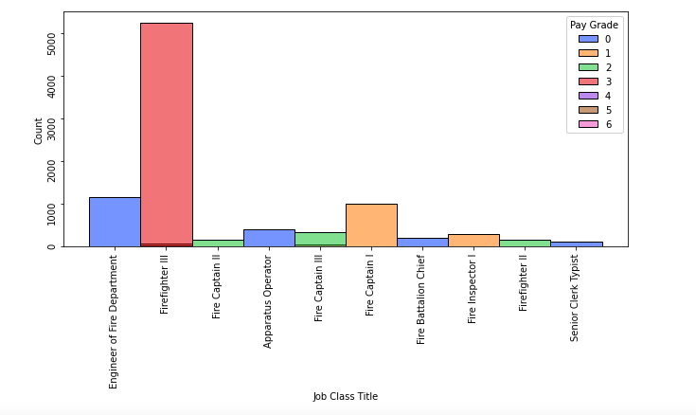
Job Titles: Filtered

Slide 14
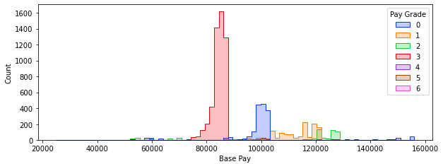
Base Pay based on Pay Grade

Slide 15
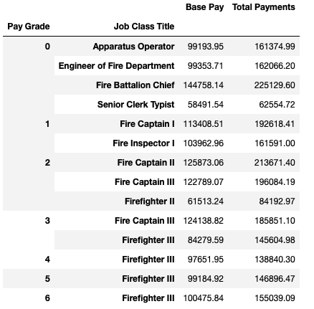
Base Pay per Job Class

Slide 16
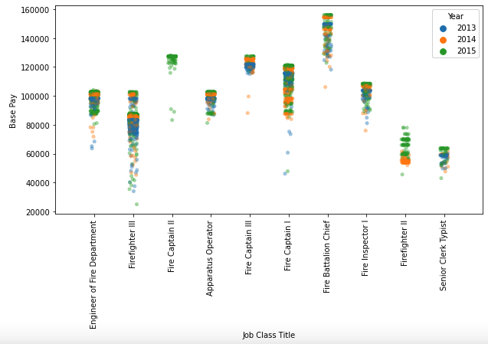
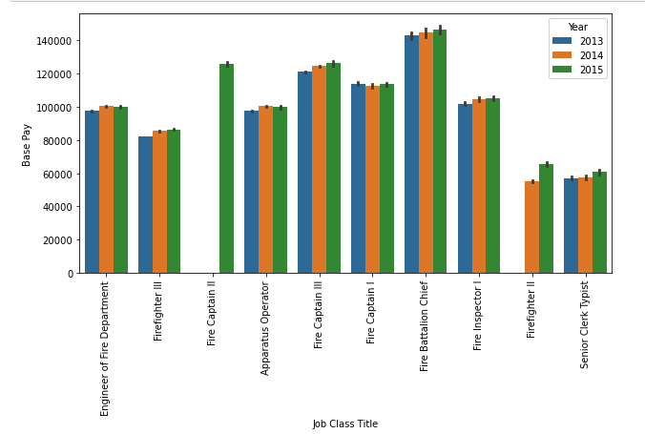
Yearly Data

Slide 17
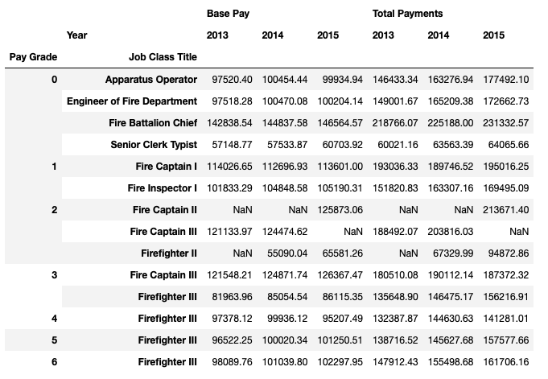
Data Summary

Slide 18

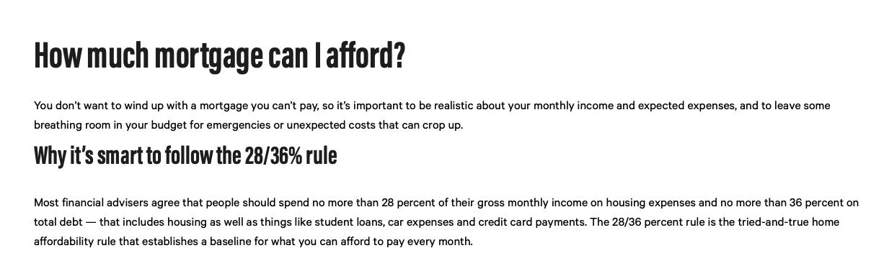
House affordability

